Slide 1
Employee Data Analysis using Excel
STUDENT NAME: VIJAYALAKSHMI.S
REGISTER NO: 312217170
DEPARTMENT: B.COM CA
COLLEGE: SHRI KRISHNASWAMY COLLEGE FOR WOMEN

Slide 2
PROJECT TITLE
Employee Performance Analysis using Excel

Slide 3


AGENDA
Problem Statement
Project Overview
End Users
Our Solution and Proposition
Dataset Description
Modelling Approach
Results and Discussion
Conclusion
3/21/2024 Annual Review

Slide 4

PROBLEM STATEMENT
The objective is to analyze employee data to uncover trends,
identify key performance indicators,
and provide actionable insights to improve overall
organizational efficiency and employee satisfaction.
This analysis aims to address issues related to employee turnover,
performance variability, and workforce management.

Slide 5

PROJECT OVERVIEW
This project involves analyzing a comprehensive employee dataset using
Excel to generate insights that will support HR and management decision-making processes.
The analysis will include exploring various employee demographics,
performance metrics, and job satisfaction levels to understand
the factors contributing to workforce dynamics.
.

Slide 6

WHO ARE THE END USERS?
The primary end users of this analysis are:-
*Human Resources (HR) Department*: To utilize the insights for talent management,
recruitment strategies, and employee retention.-
*Management/Executives*: To make informed decisions regarding workforce
planning and organizational development.-
*Team Leaders*: To understand team dynamics and improve employee
engagement and productivity.

Slide 7

OUR SOLUTION AND ITS VALUE PROPOSITION
We propose leveraging Excel's data analysis tools to perform the following:-
*Descriptive Analytics*: Summarize the key characteristics of the employee population
(e.g., average tenure, age distribution, etc.).-
*Diagnostic Analytics*: Identify patterns and correlations in employee performance and satisfaction data.-
*Predictive Analytics*: Use regression analysis to predict future trends in employee turnover and performance based on current data.-
*Prescriptive Analytics*: Provide recommendations for HR and management based on the analysis.

Slide 8
Dataset Description
The dataset contains detailed information on employees, including:-
*Demographics*: Age, gender, education level, etc.-
*Job Details*: Department, job title, years of service, salary, etc.-
*Performance Metrics*: Performance ratings,
promotions, training completion, etc.-
*Engagement and Satisfaction*: Survey scores, feedback, etc.-
*Exit Data*: Reasons for leaving, exit interviews, etc.

Slide 9
MODELLING
*Data Cleaning and Preparation*: Handling missing data, outliers, and ensuring consistency.-
*Descriptive Statistics*: Using Excel functions to summarize data (e.g., averages, standard deviations).-
*Pivot Tables and Charts*: Creating pivot tables to explore relationships and trends in the data.-
*Correlation and Regression Analysis*: Utilizing Excel’s data analysis tool pak to identify correlations and build regression models.-
*Dashboards*: Creating interactive Excel dashboards to visualize key findings.
9

Slide 10
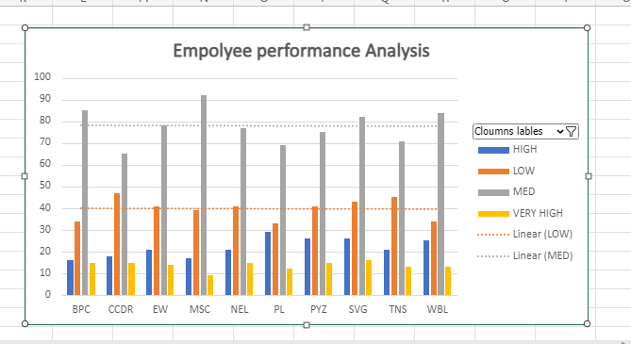
RESULTS
10

Slide 11
conclusion
The analysis provided actionable insights that can help improve employee retention, enhance performance management, and support data-driven decision-making within the organization. By addressing the identified issues, the organization can foster a more productive and satisfied workforce.

